Slide 1
NW Cluster Testing
10/3 – 10/12

Slide 2
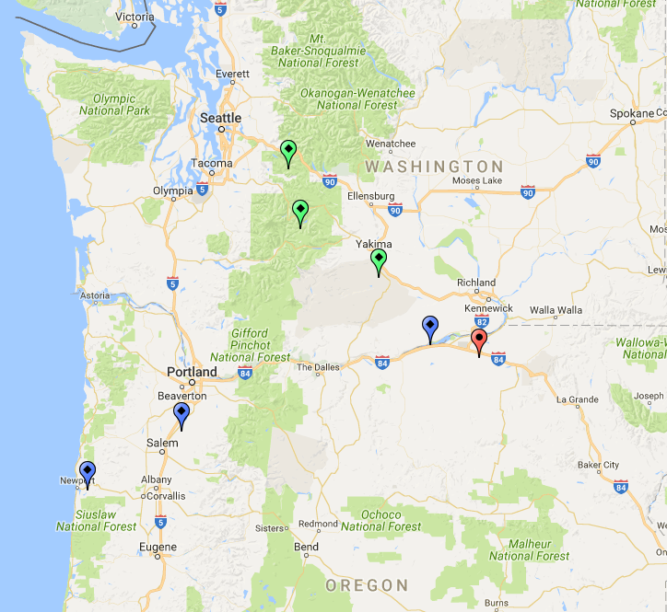
Overview
4 Oregon Bridges (PS)
3 Washington Bridges
34,400 ft² deck area (NBI)
Average Deck Condition: 6.4

Slide 3
Pertinent NBI Info
 | NBI Number | Year Built | ADT | Number of Spans | Total Length | Lanes - Shoulder | Deck Area (ft²)
Bridge 1 | 18049 033 02544 | 2000 | 4700 | 1 | 110 ft | 2-2 | 5050
Bridge 2 | 18277 160 01866 | 1997 | 4300 | 1 | 70 ft | 2-2 | 2900
Bridge 3 | 16611 002 16576 | 1984 | 8080 | 1 | 109 ft | 2-2 | 4720
Bridge 4 | 09578 006 19516 | 1968 | 7474 | 3 | 162 ft | 2-2 | 7070
Bridge 5 | 0011631B0000000 | 1980 | 11623 | 1 | 104 ft | 2-0 | 4260
Bridge 6 | 0013198A0000000 | 1987 | 659 | 1 | 120 ft | 3-2 | 4250
Bridge 7 | 0009217C0000000 | 1972 | 14603 | 1 | 112 ft | 2-1 | 6170

Slide 4
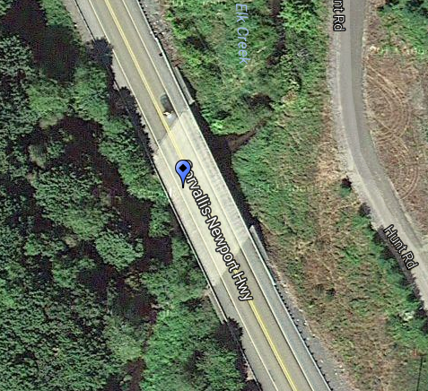
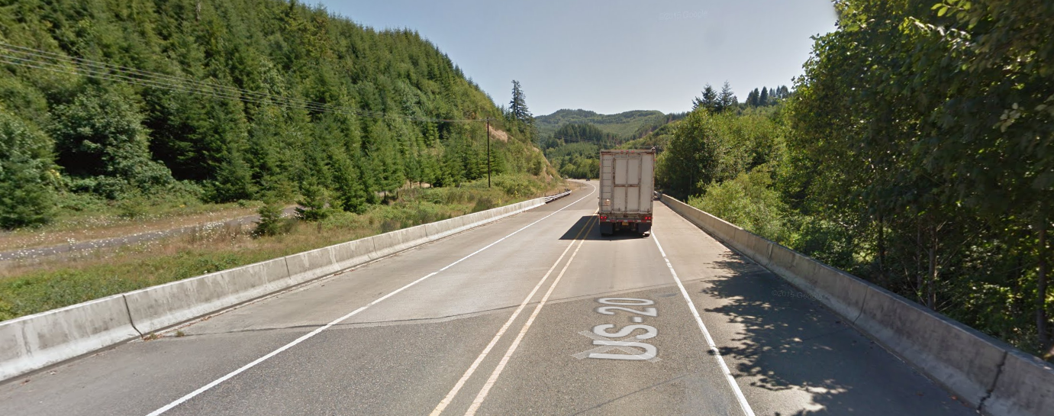
Bridge 1
Length: 110 ft.
Year: 2000
Skew: 30°

Slide 5
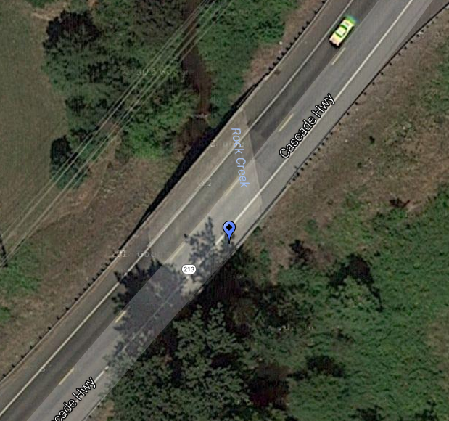
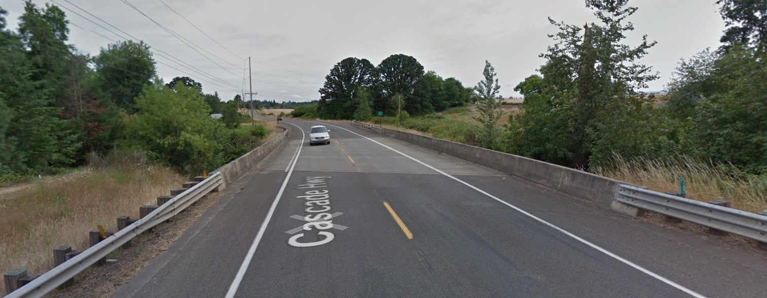
Bridge 2
Length: 70 ft.
Year: 1997
Skew: 45°

Slide 6
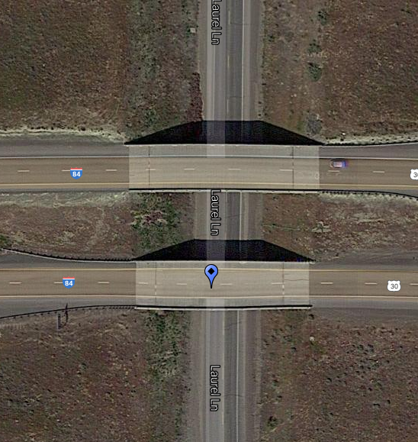
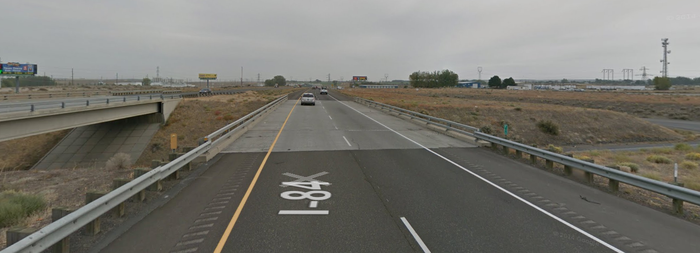
Bridge 3
Length: 109 ft.
Year: 1984

Slide 7
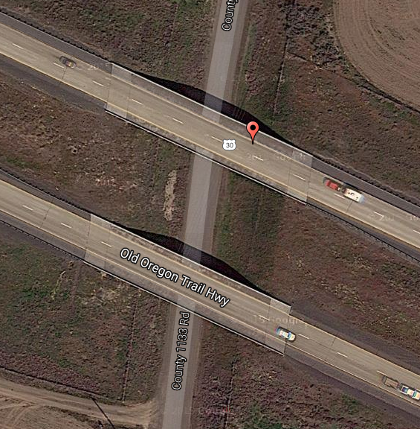
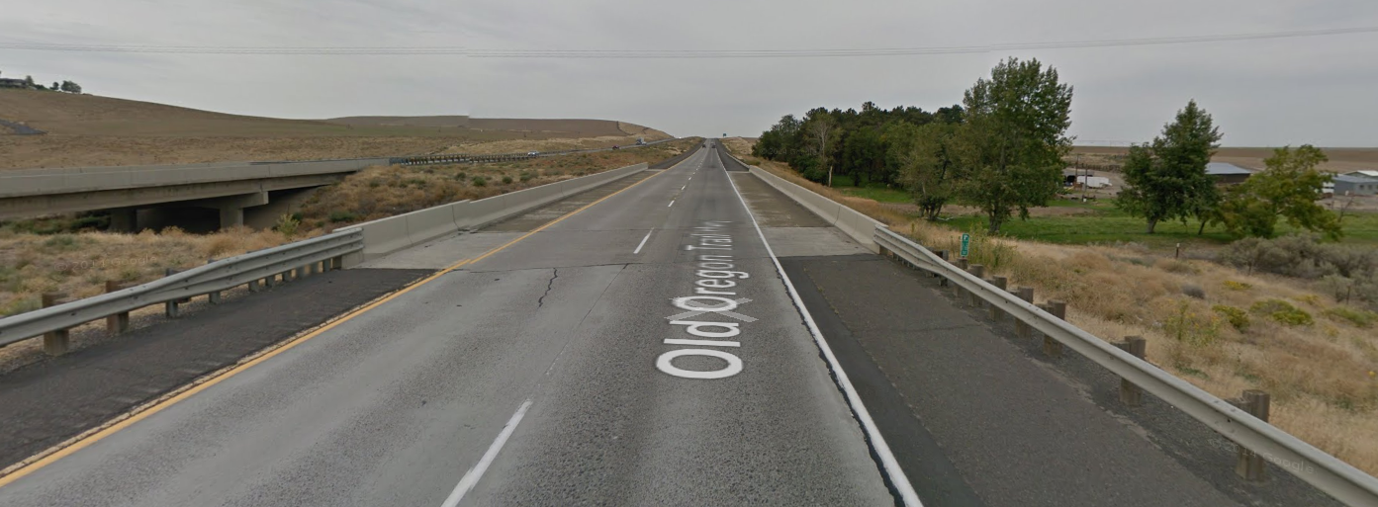
Bridge 4
Length: 162 ft.
Year: 1968
Skew: 16°

Slide 8
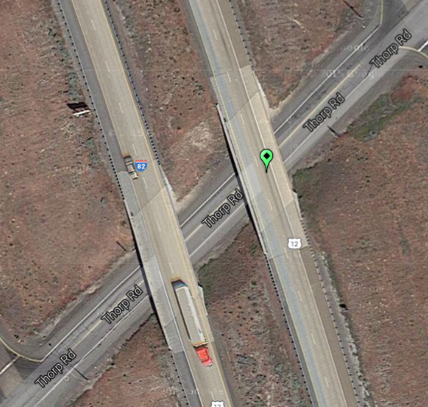
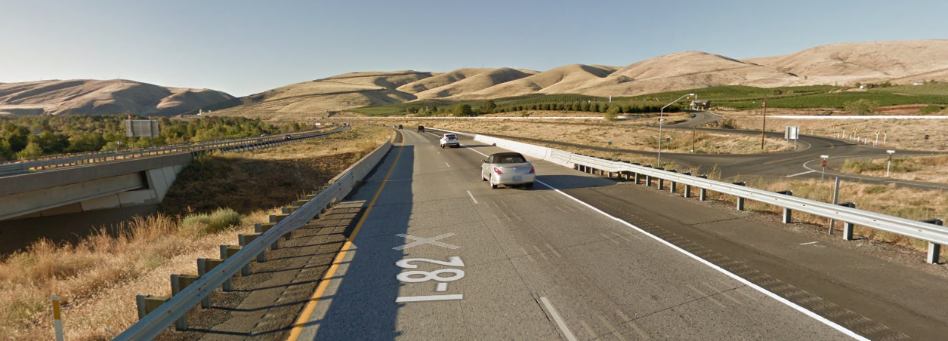
Bridge 5
Length: 104 ft.
Year: 1980
Skew: 27°

Slide 9
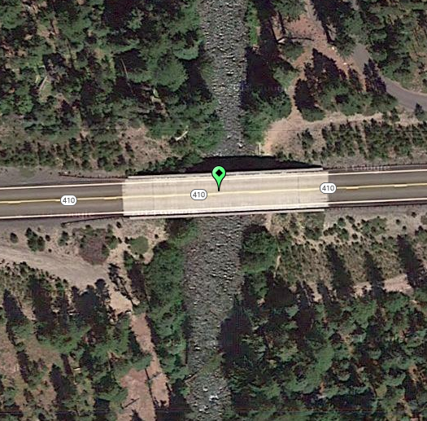
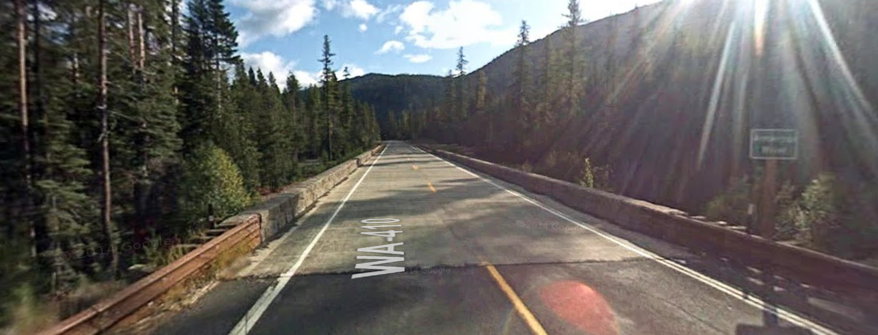
Bridge 6
Length: 120 ft.
Year: 1987

Slide 10
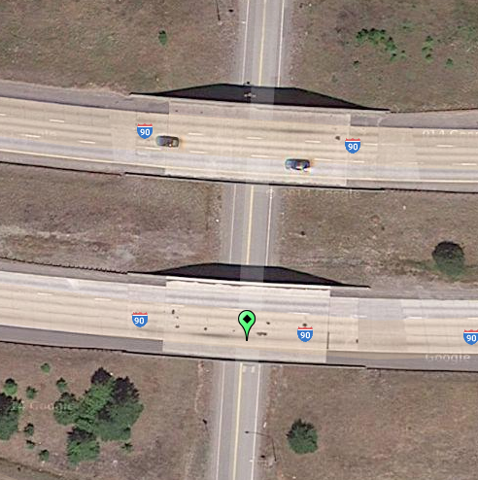
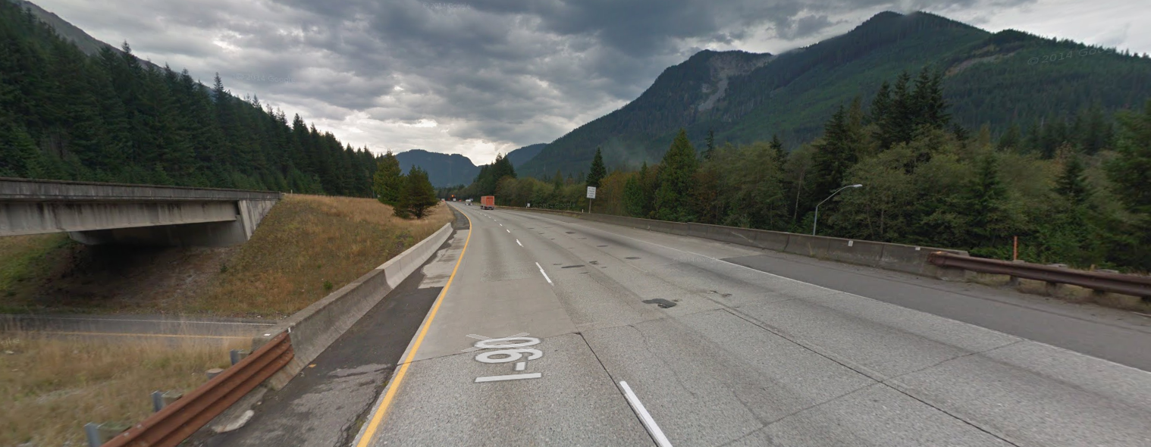
Bridge 7
Length: 112 ft.
Year: 1972
Skew: 27°

